Slide 1
VTL sandbox
2018 SDMX Expert workshop
OECD 22-25.10.2018
Eurostat

Slide 2
The VTL sandbox
VTL 2.0 parser and interpreter (all operators)
Extensions for loading data, handling exceptions and control flow (can be disabled)
Simple user interface
Java source code
Sample programs
User manual

Slide 3
The VTL sandbox
What you need to run the sandbox:
Java version 7 or higher
access to an Oracle database: database URL, username and password (Oracle version 11.2 or higher)
Can be downloaded from Eurostat github – VTL
A few parameters of the operators 2.0 are not implemented:
join operator: only identifier components can be used in the using clause
hierarchy, check_hierarchy: only the modes non_null and partial_null are implemented, and only output=dataset is implemented
cast: not all cast conversions are implemented

Slide 4
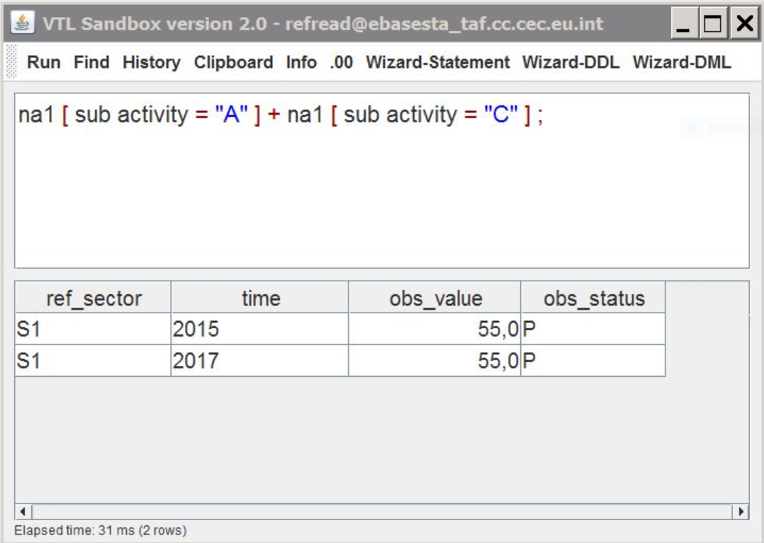
VTL sandbox – simple user interface

Slide 5
The parser
the parser converts the VTL program (string of characters) to a syntax tree (or generates a syntax error)
*
/
100
ds_bop
ds_gdp
ds_bop / ds_gdp * 100
parser

Slide 6
The interpreter
For VTL-ML expressions, the interpreter reads the syntax tree, builds the corresponding SQL statements and executes them (or raises a run-time error)
*
/
100
ds_bop
ds_gdp
SELECT
a.ref_area, a.partner, a.time,
a.obs_value / b.obs_value * 100
FROM
ds_bop AS a
JOIN ds_gdp AS b
ON a.ref_area = b.ref_area
AND a.time = b.time
interpreter
For VTL-DL statements: stores the metadata into the system tables and, in some cases, creates the database objects (or raises a type error)

Slide 7
Saving and retrieving VTL code
*
/
100
ds_bop
ds_gdp
ds_bop / ds_gdp * 100
parser
save
retrieve
Meta-base (relational table)
Object id | Serial index | Node type | Children | Value
1 | 1 | MULTIPLY | 2
1 | 2 | DIVIDE | 2
1 | 3 | IDENTIFIER | 0 | ds_bop
1 | 4 | IDENTIFIER | 0 | ds_gdp
1 | 5 | NUMBER | 0 | 100

Slide 8
Managing data and metadata
The data contained in a dataset are stored in a relational table (a table column for each dataset component).
The metadata (structural metadata, programs, rulesets, code lists) are stored in relational tables (the meta-base tables).
All data manipulations are executed by running SQL statements: there is no direct data manipulation.

Slide 9
Software architecture
The parser, the interpreter and the user interface are written in Java.
The communication with the SQL database is carried out using the JDBC library (this assures some degree of independence from the specific DBMS used).
Suitable improvement: re-write some parts (that are using Oracle proprietary features) to connect to other DBMSs, e.g. an open source DBMS like PostgreSQL

Slide 10
VTL sandbox – main functions
Button | Action
Run | Execute the VTL code and displays the resulting data in a table
Wizard ML | Help writing the VTL syntax and selecting existing components
Wizard DL | Help writing the VTL syntax of VTL-DL statements
Wizard Statements | Help writing the statements
Find | Show the VTL syntax of an existing VTL object
History | Show the history of execution (including past sessions)
Info | Show the generated SQL query and syntax tree
.00 | Set the number of decimal places displayed for numeric data
Label | Change the label displayed with the data
Export all | Exports all data and metadata in a syntax that can be executed

Slide 11
VTL sample code (outliers detection from the ESA domain)
// outliers detection (input dataset: na_main) // compute observation value of previous time period
ds_prec | := | na_main [ calc precval := lag ( obsval, 1 over ( order by time ) ) ]
// compute difference in percentage and absolute value // the filter is needed to avoid possible run-time error "division by zero"
ds_diff | := | ds_prec [ filter precval <> 0 ] [ calc diffperc := abs ( obsval - precval ) / precval ] [ calc diffabs := abs ( obsval - precval ) ]
ds_invalid | := | check ( ds_diff # diffperc < 0.03 errorcode "Deviation > 3%" errorlevel "Warning" invalid )
outliers | := | inner_join ( ds_invalid, ds_diff ) [ keep obsval, diffabs, errorcode, errorlevel ]

Slide 12
Useful links
SDMX – VTL (VTL page on the SDMX site)
VTL projects (existing VTL implementations)
VTL quick reference guide (by the ESS TF Validation)
Principles for data validation (by the ESS TF Validation)
Main types of validation rules (by the ESS TF Validation)
CROS portal – Validation (documentation on data validation)

Slide 13

QUESTIONS ?

